Slide 1


Final Presentation
Arturo Altamirano

Slide 2
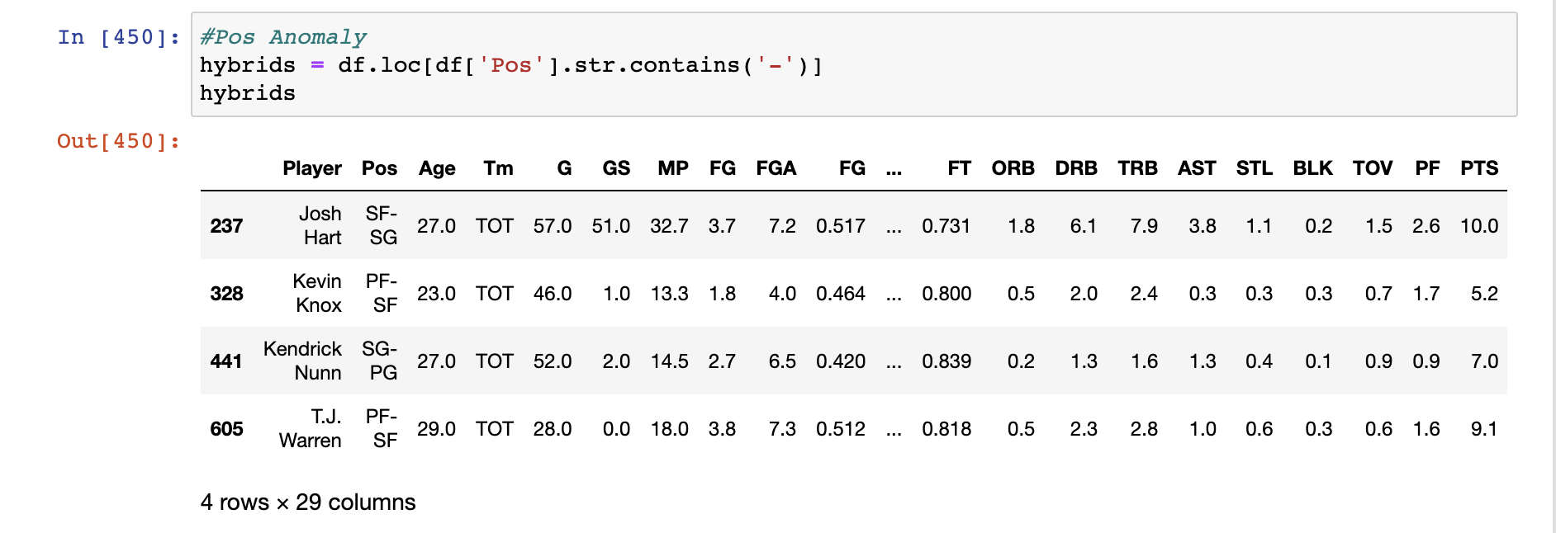
Further Cleaning
Strange position designations for recently traded players.
Not sure why this was done.
Elected to change the value to the initial value before ‘-’

Slide 3
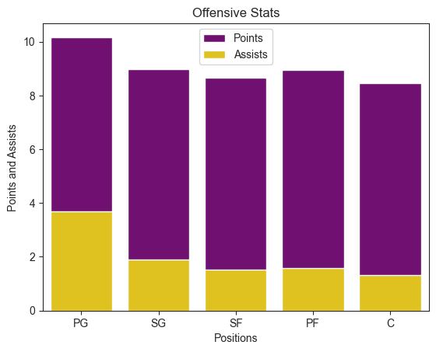
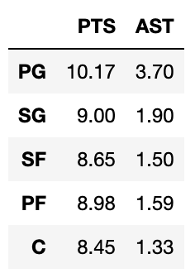
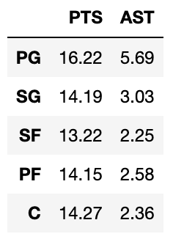
Question 1: Position and Offense
Do certain positions play more offense?
Total
High Use

Slide 4
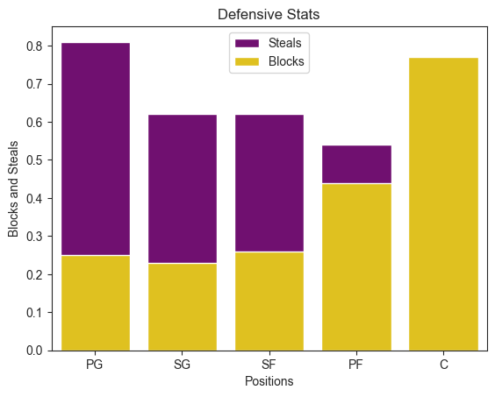
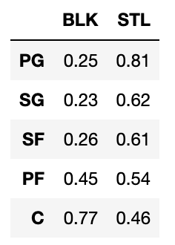
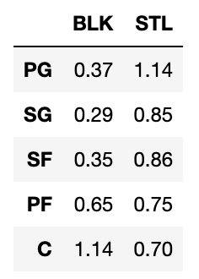
Question 1: Position and Defense
Do certain positions play more defense?
Total
High Use

Slide 5
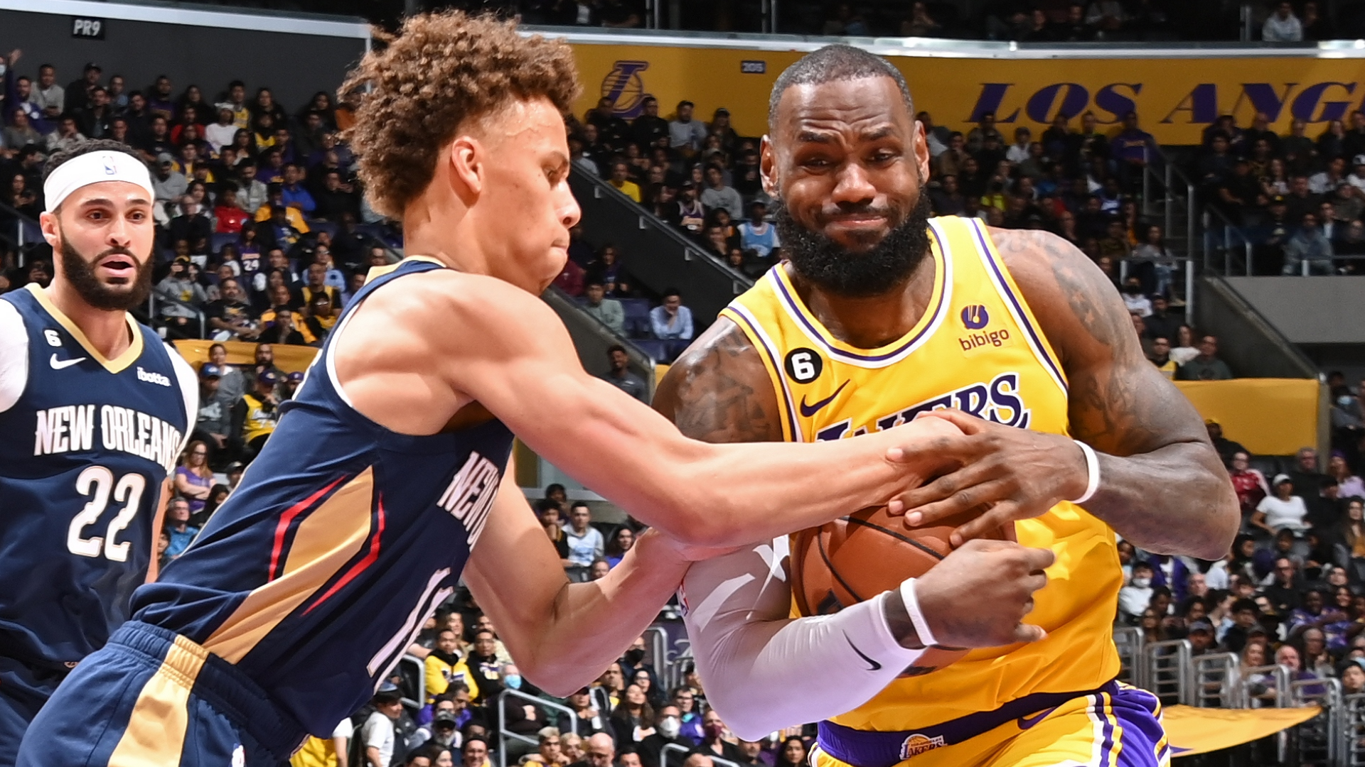
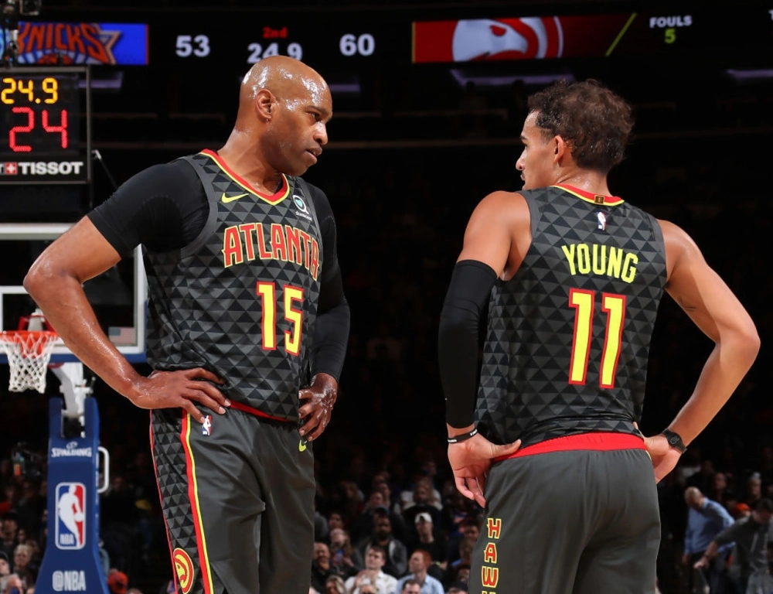
Question 1.5: Usage
What about star players? Do they have the same positional breakdowns?

Slide 6
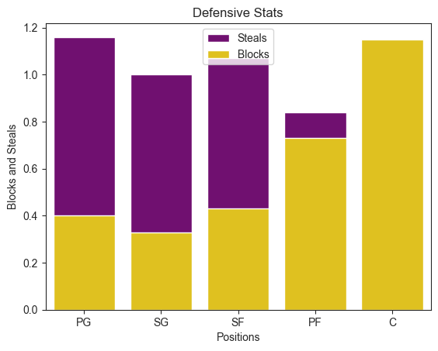

Question 1: Expanded
High use (30<MP)
Total

Slide 7
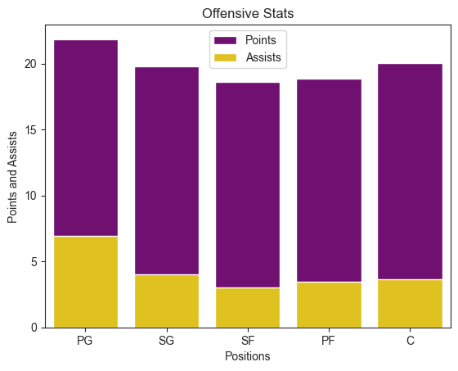
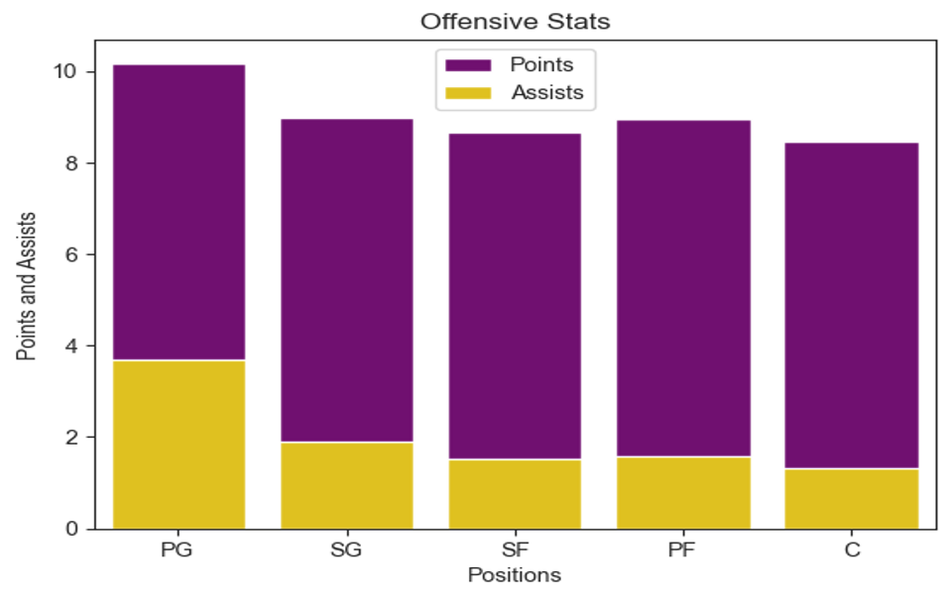
Question 1: Expanded
High use (30<MP)
Total

Slide 8
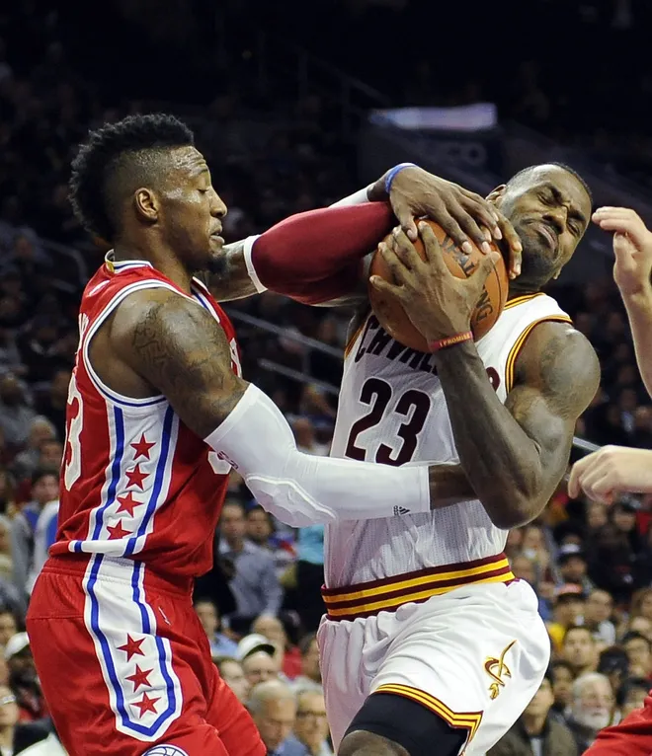
Question 1: Explanation
Robert Covington defending Lebron James
Why are statistical rates so similar?
The skill gap between superstars and rotation players is very slight and the nature of the game does not vary much.
Playtime determines statistical output for most players at an exponential rate. And only so many minutes exist in a game.

Slide 9
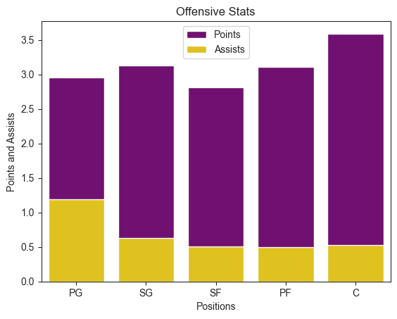
Question 1: Final
High use (30<MP)
Low use (15>MP)

Slide 10
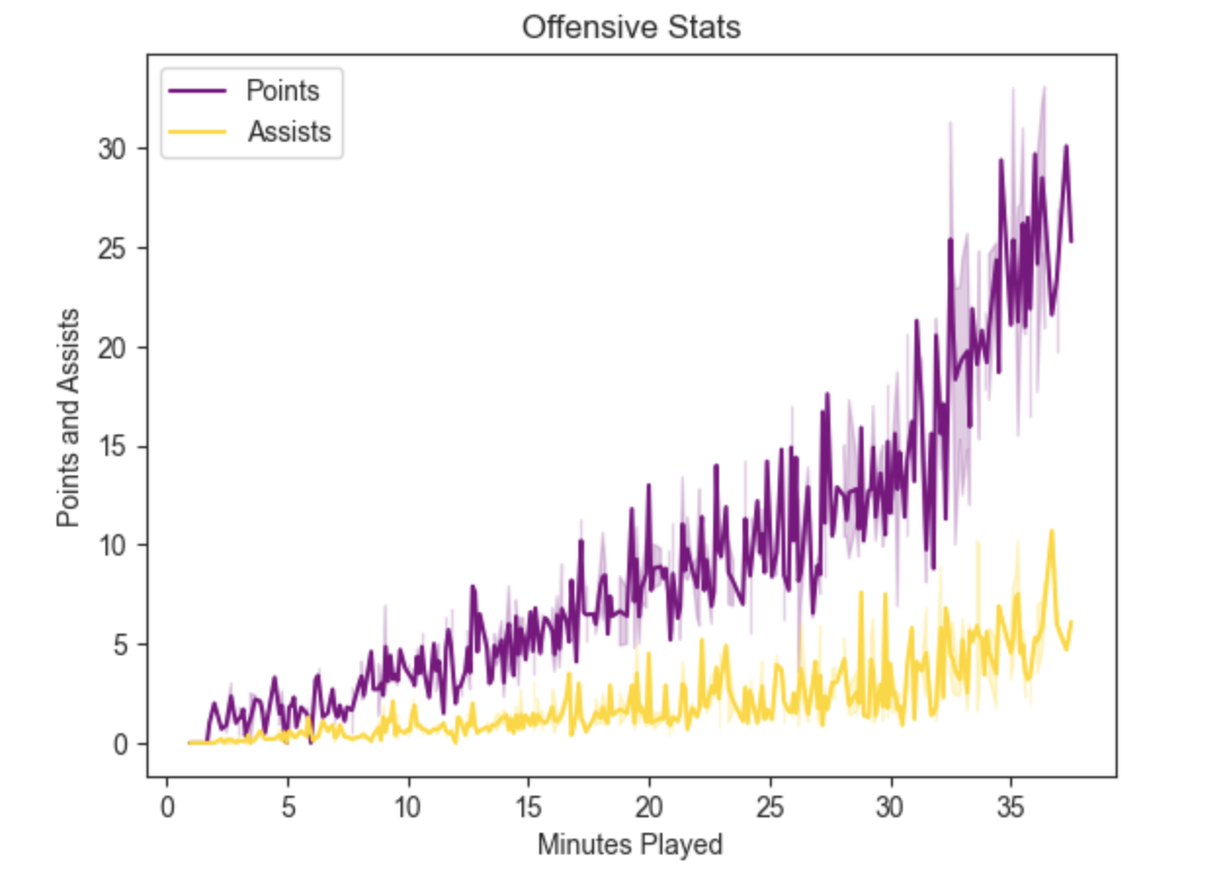
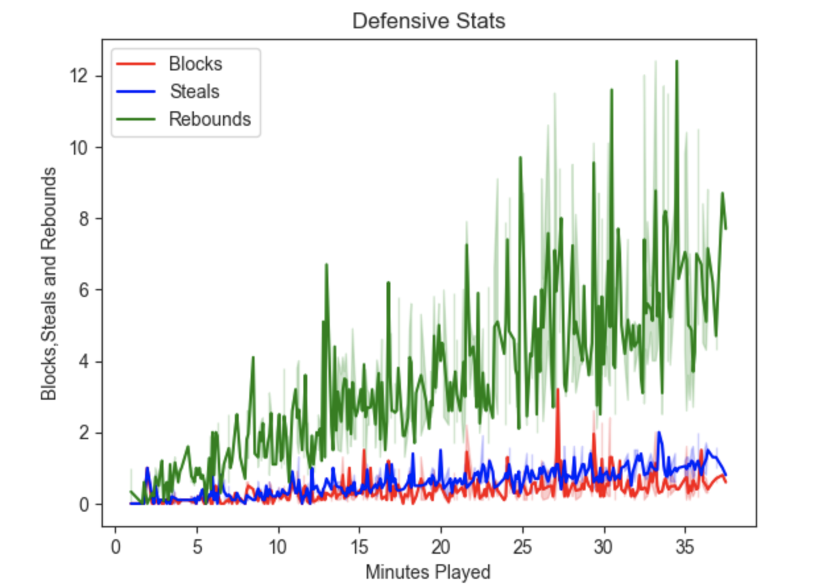
Question 2: Usage and Stats
How does a player’s usage affect their statistics?

Slide 11
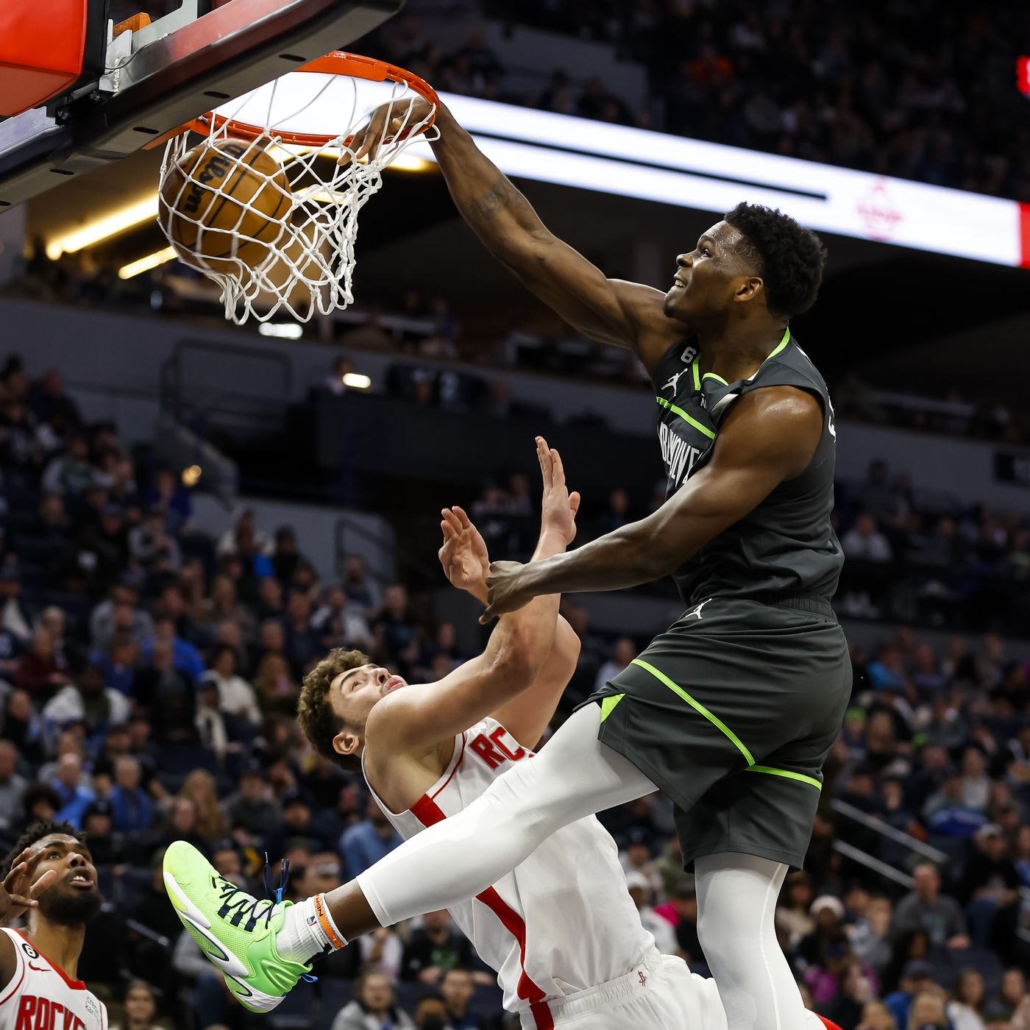
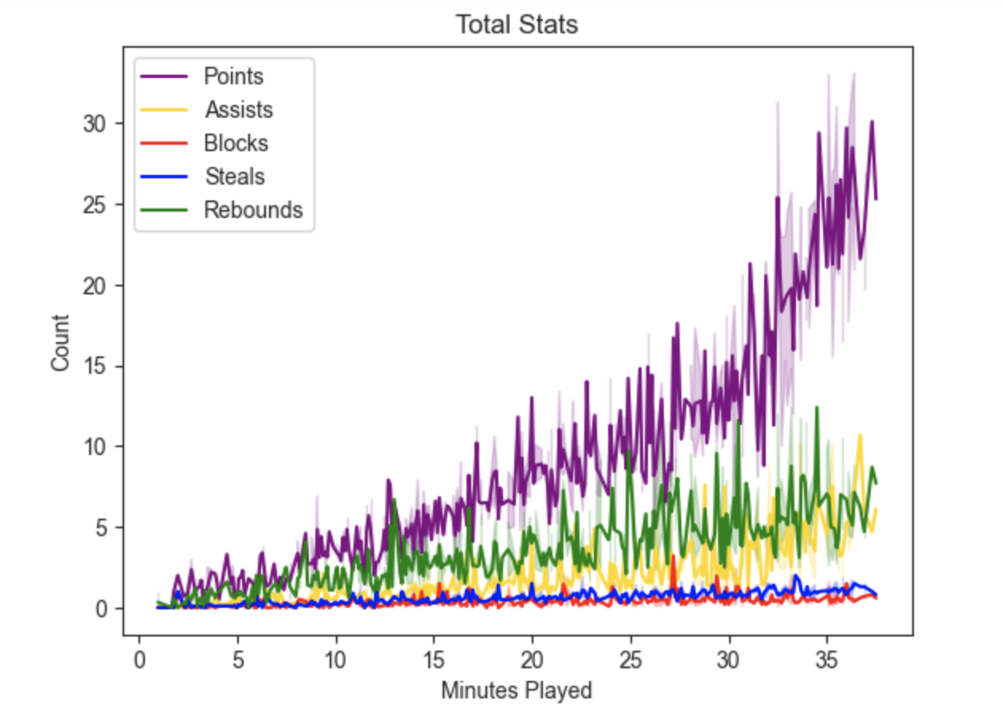
Question 2: Expanded
Conclusion: The NBA is an offensive-minded league that prioritizes scoring.
“Great offense beats great defense”
Note: Defensive impact is often hard to indicate statistically

Slide 12
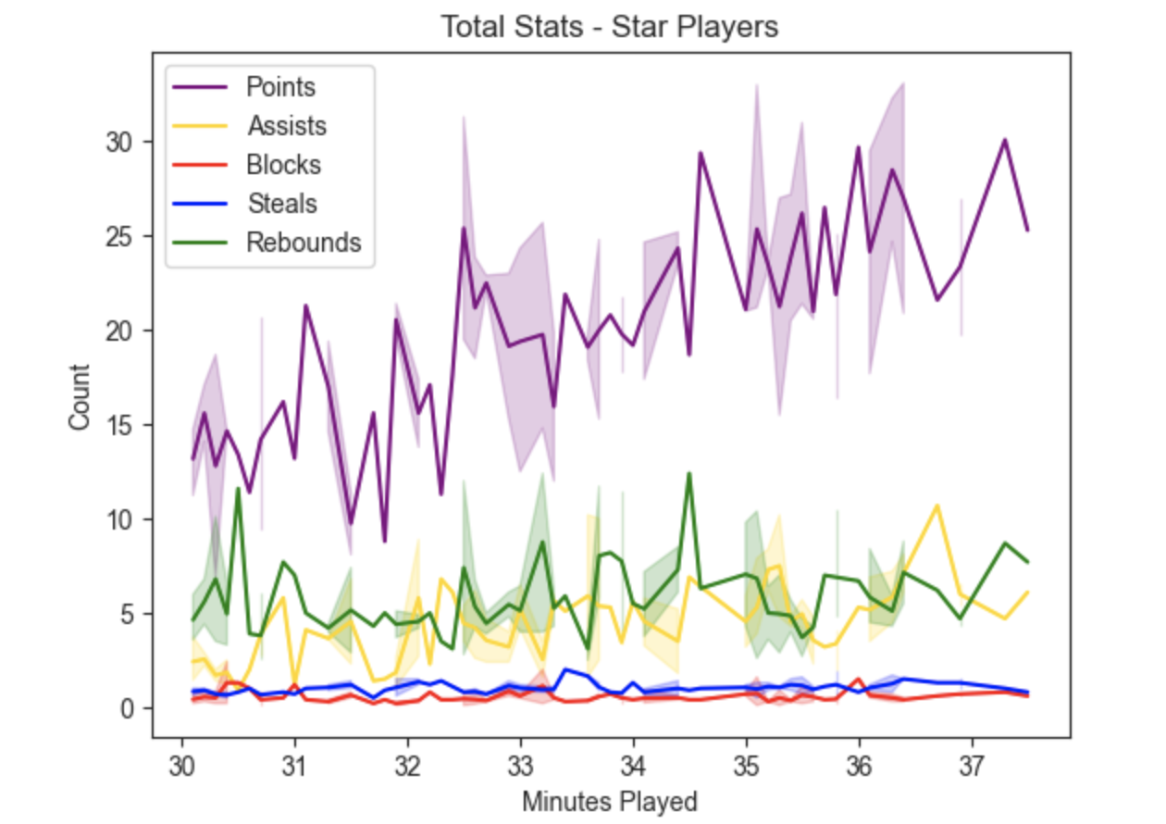
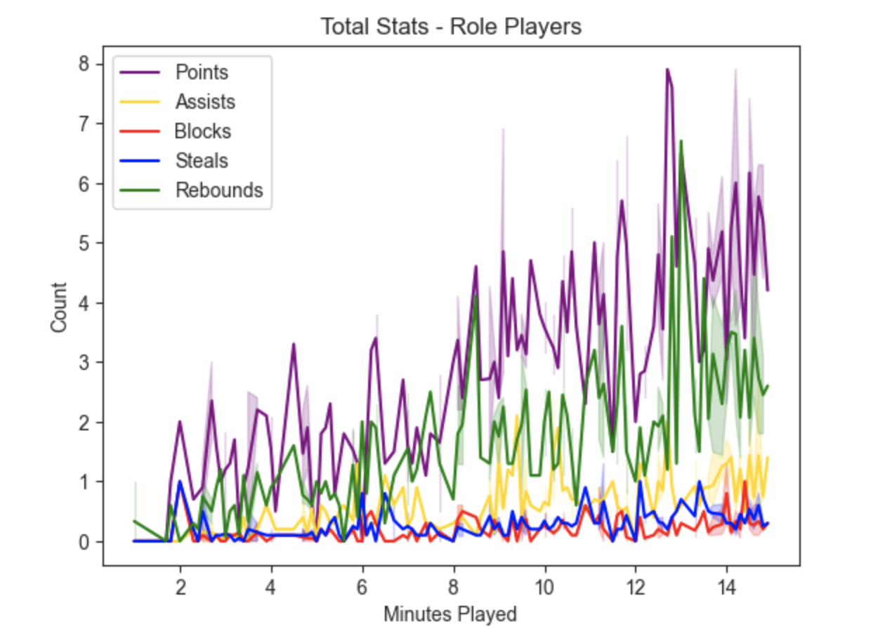
Question 2: Expanded
Trend mostly replicated among star and role players.

Slide 13
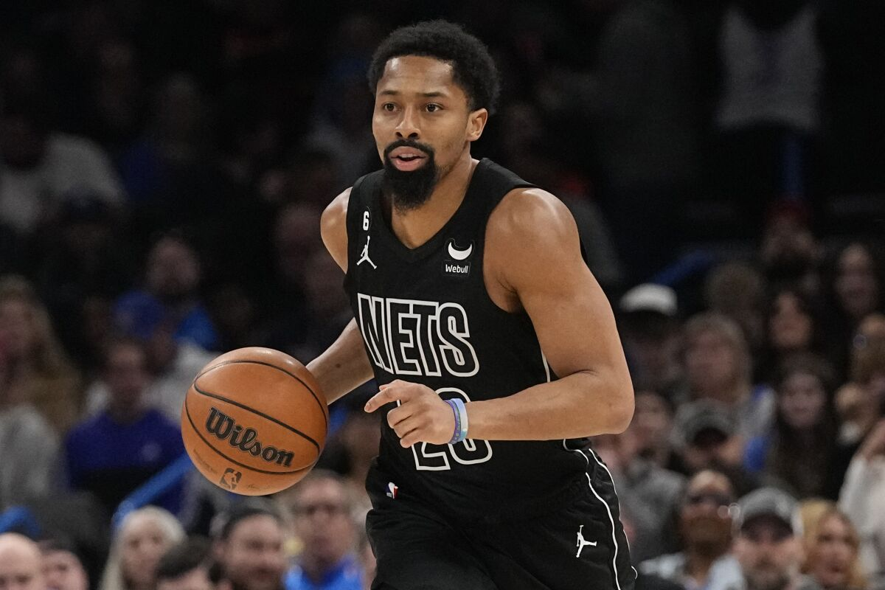
Question 3: Traded Player Trends
Are there any noticeable trends among players who have been recently traded?
Are traded players most frequently of a certain age group?
What is the utilization of traded players like?
(How many minutes do they play?)

Slide 14
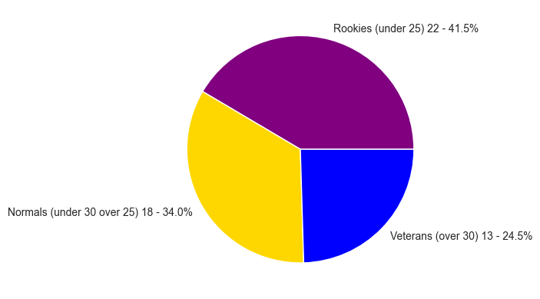
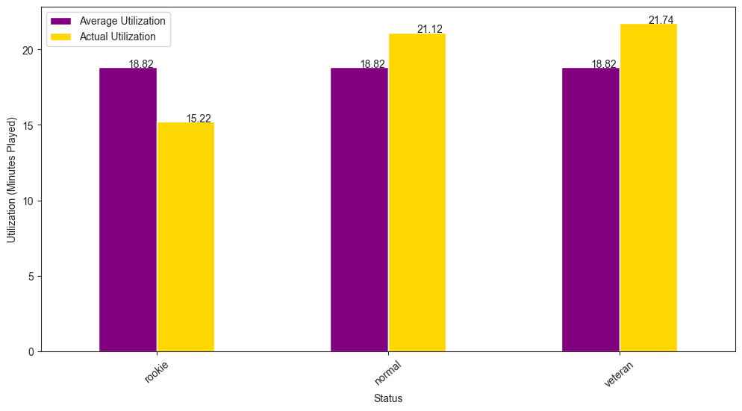
Question 3: Expanded
All age brackets appear to be evenly represented.
However, rookies receive less playing time than veterans.

Slide 15
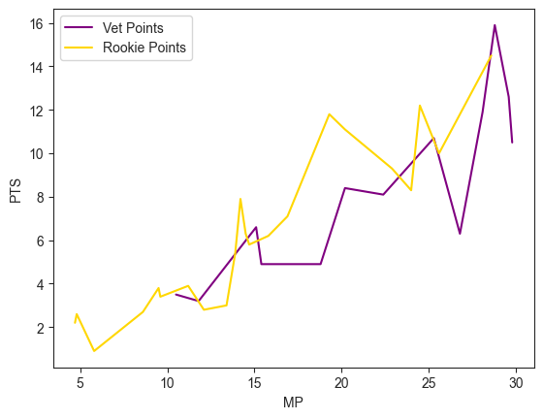
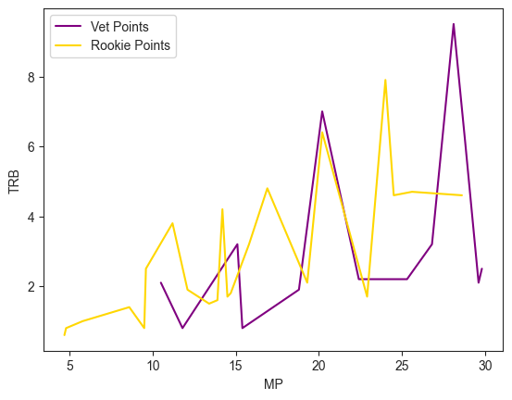
Question 3: Expanded

Slide 16
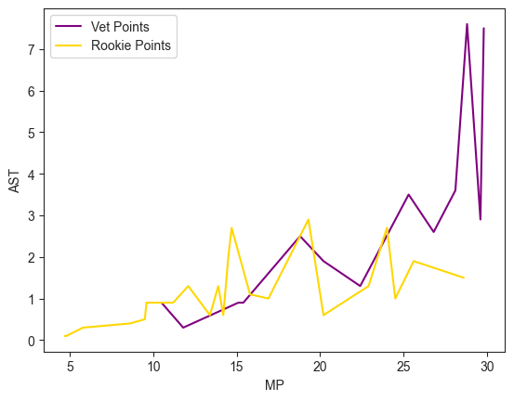
Question 3: Expanded
Veteran-traded players display the ability to produce more with extended minutes.
The strange gap between 15-20 minutes may be an anomaly of the limited scope of this data set.

Slide 17
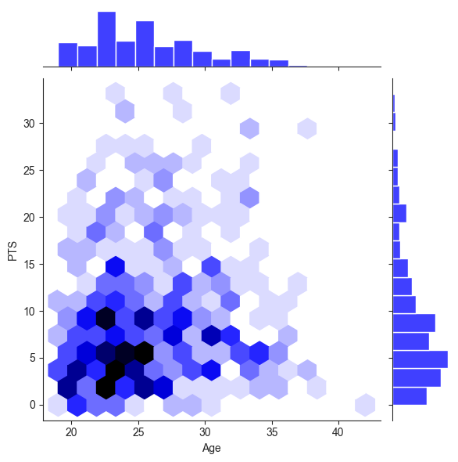
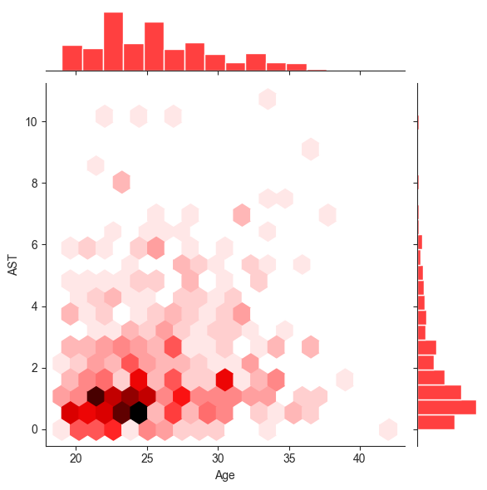
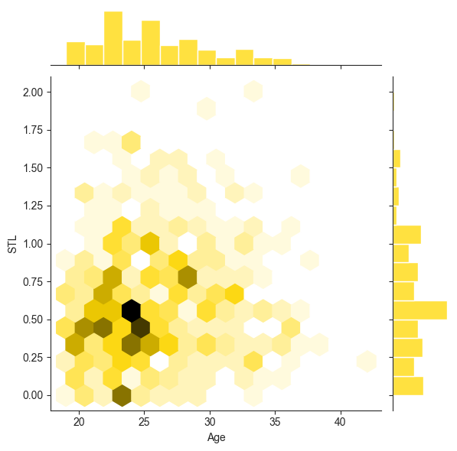
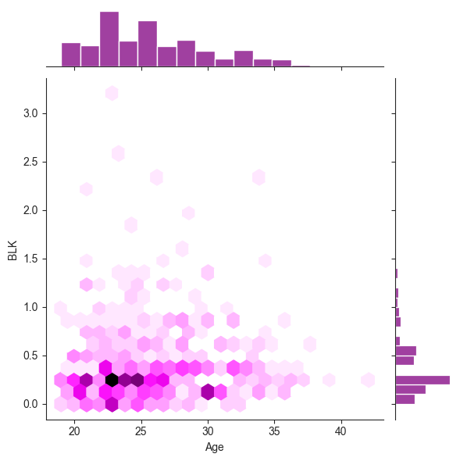
Question 4: Age
Does age influence average player production?

Slide 18
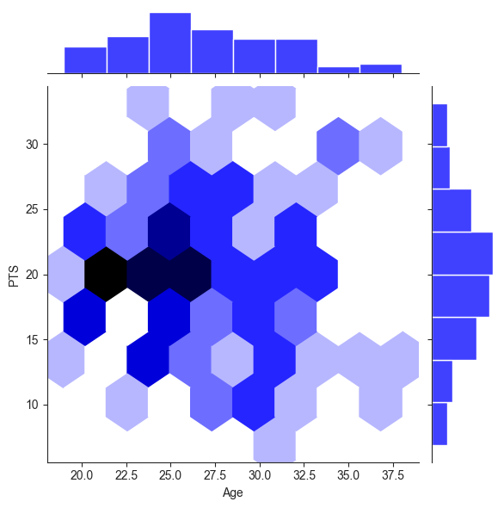
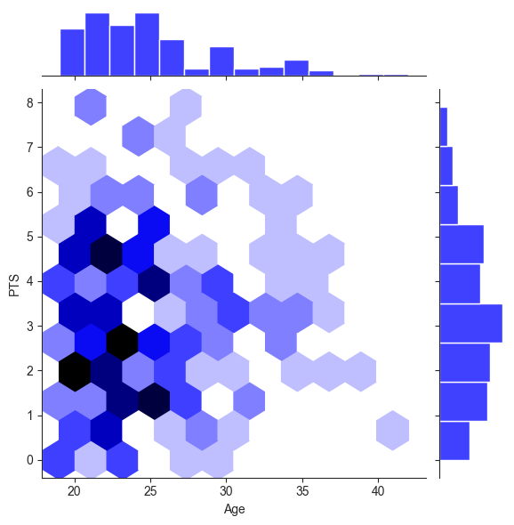
Question 4: Expanded
High use (30<MP)
Low use (15>MP)

Slide 19
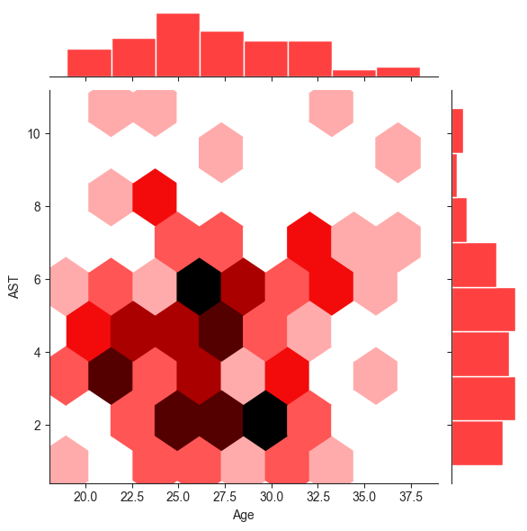
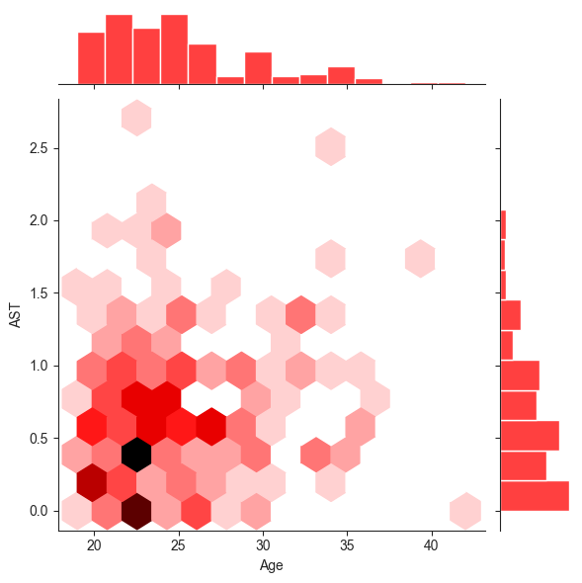
Question 4: Expanded
High use (30<MP)
Low use (15>MP)

Slide 20
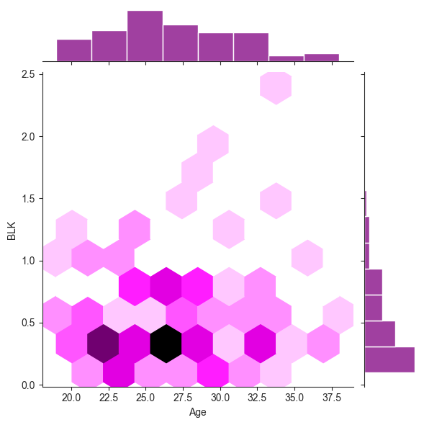
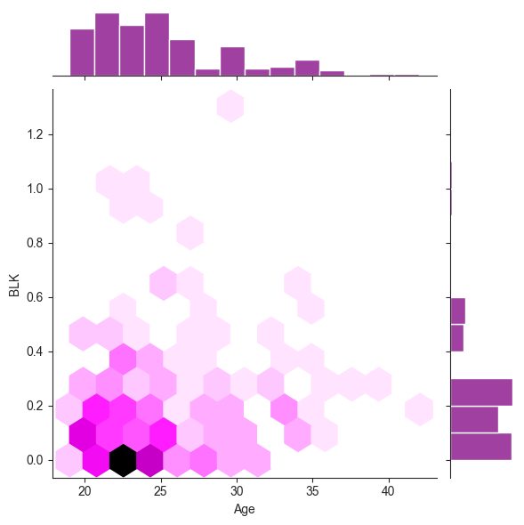
Question 4: Expanded
High use (30<MP)
Low use (15>MP)

Slide 21
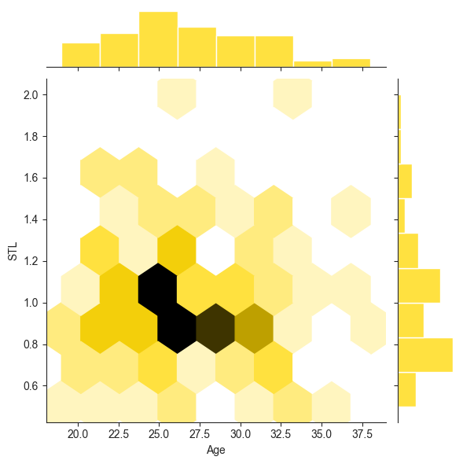
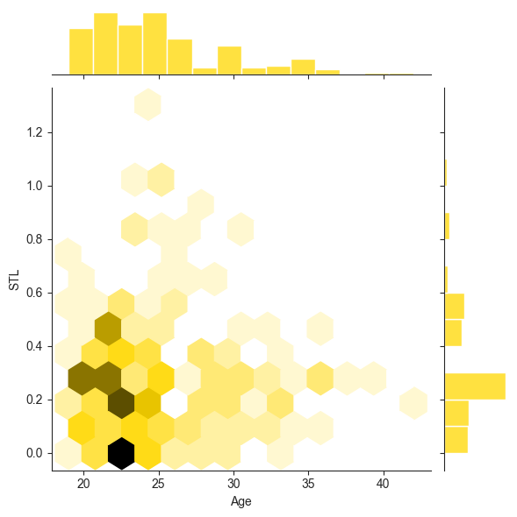
Question 4: Expanded
High use (30<MP)
Low use (15>MP)

Slide 22
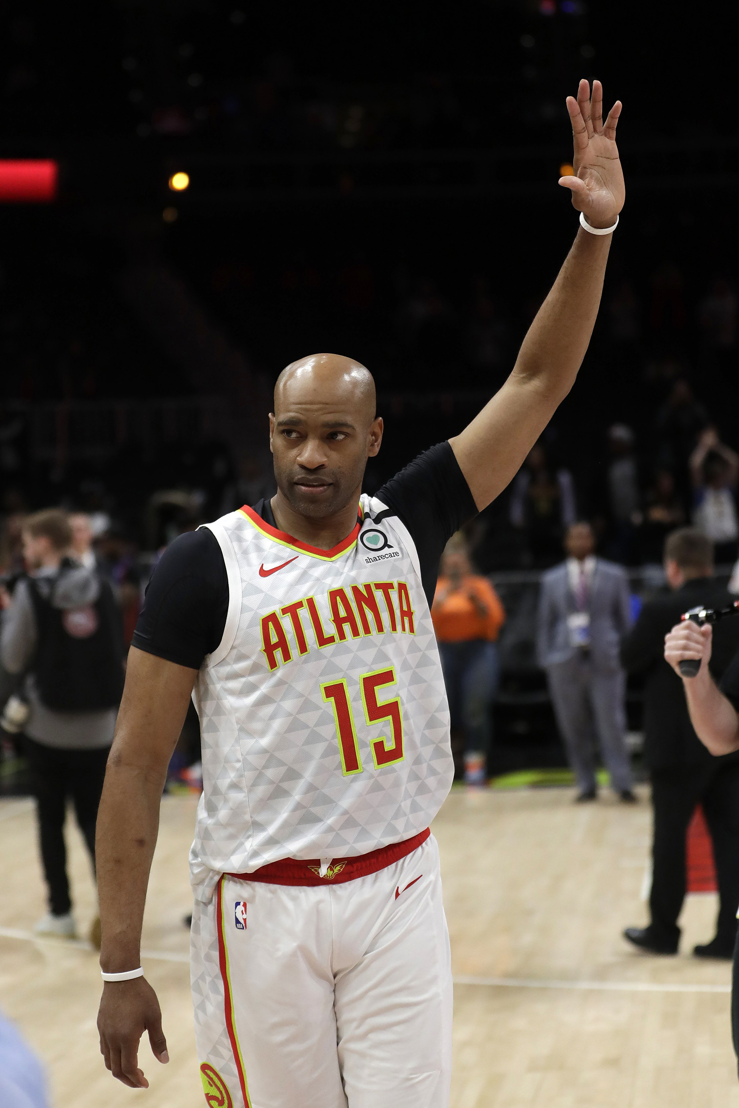
Question 4: Final
Vince Carter, 42
Most players peak in their mid-20s, and most non-stars play in the league only until their late 20s.
Superstars are more likely to find ways to continue their output as their athleticism declines, whereas rotation players lose positions to younger replacements.
Usually, players must decrease minutes as they age, to allow them to keep the same level of production.
Vince played 22 seasons in the NBA

Slide 23
Question 5: Team Trends
Which teams win and why do they win?
Does age have a large effect on winning?
Do three-pointers help teams win more often?
General insight into statistical trends of winning/losing teams

Slide 24
Question 5: Additional Resource
Records of all NBA teams (Wins-Losses)
Title: NBA teams record prior all-star break
Source: Statmuse.com
https://www.statmuse.com/nba/ask/nba-teams-record-prior-all-star-break

Slide 25
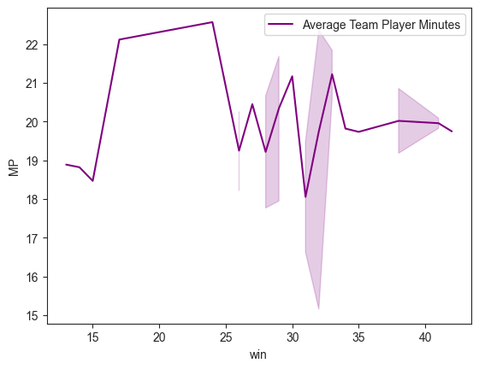
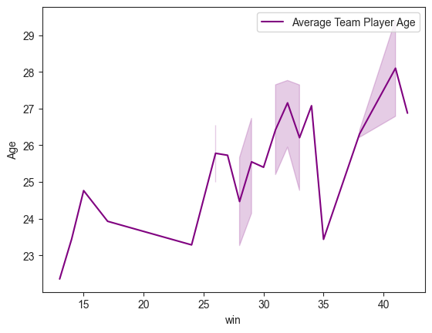
Question 5: General
Older teams win more.
You want to balance player load moderately around 20 minutes per game.
Minutes
Age

Slide 26
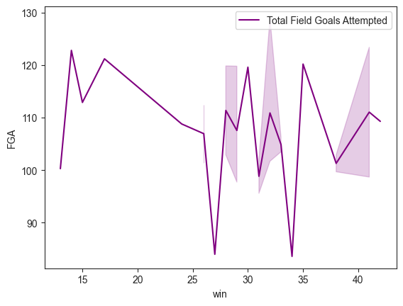
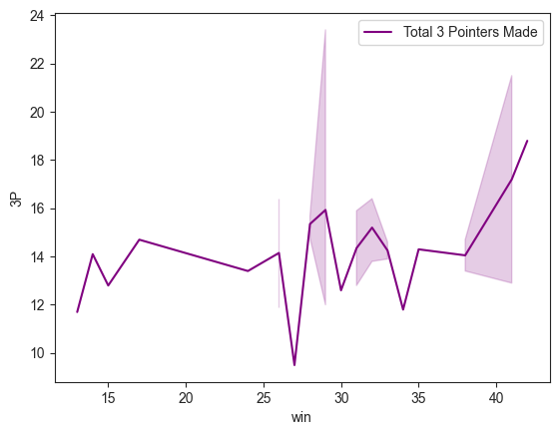
Question 5: Offense
The best teams make a lot of 3s and take a moderate to an above-average number of total shots.
The dips in the plots represent teams that play at a slower pace. By playing at a slow pace, you also limit the opposing team’s ability to score.

Slide 27
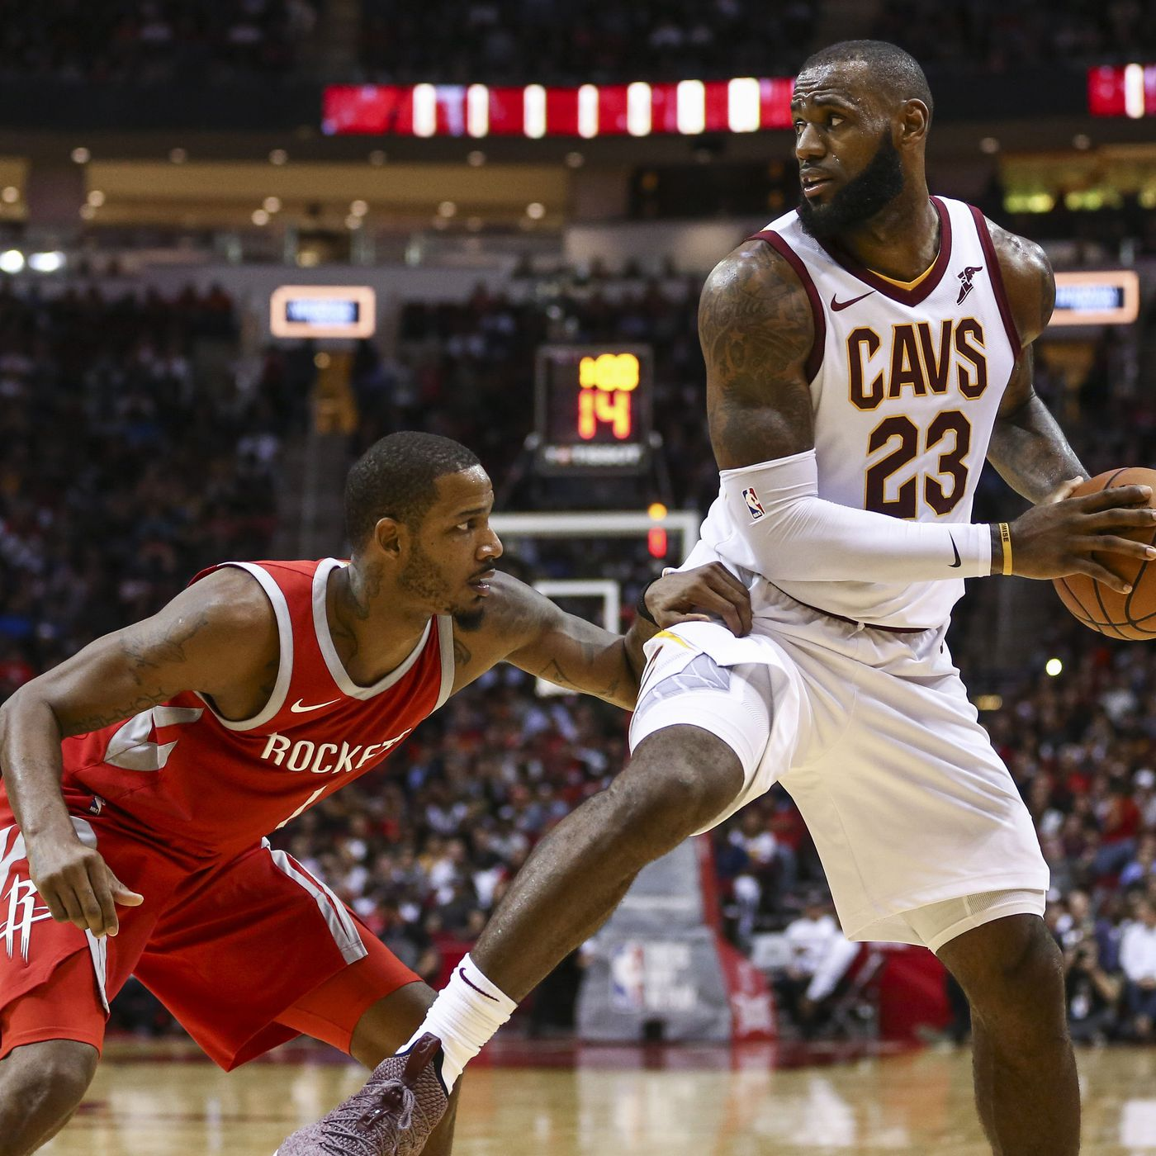
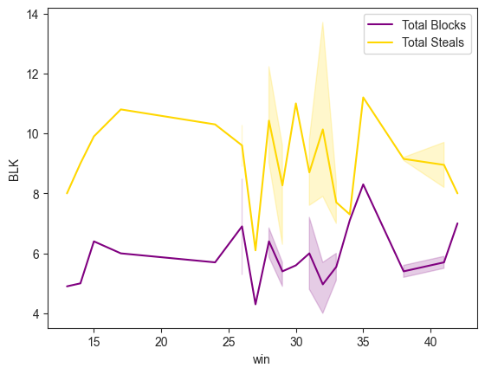
Question 5: Defense
The correlation between defense and winning is still present, but less clear.
This reinforces the idea that offense is a better metric for winning in the NBA.

Slide 28
Conclusion
The NBA is an offensive-minded league.
Experience and depth of the roster matter more than youth and star power.
Players produce the most in their mid 20’s on average, but star players produce throughout their careers.
Statistical rates of production grow exponentially with minutes played but at a similar ratio between stats.
Veteran players traded during this season produce more on average than rookie players.

